Slide 1
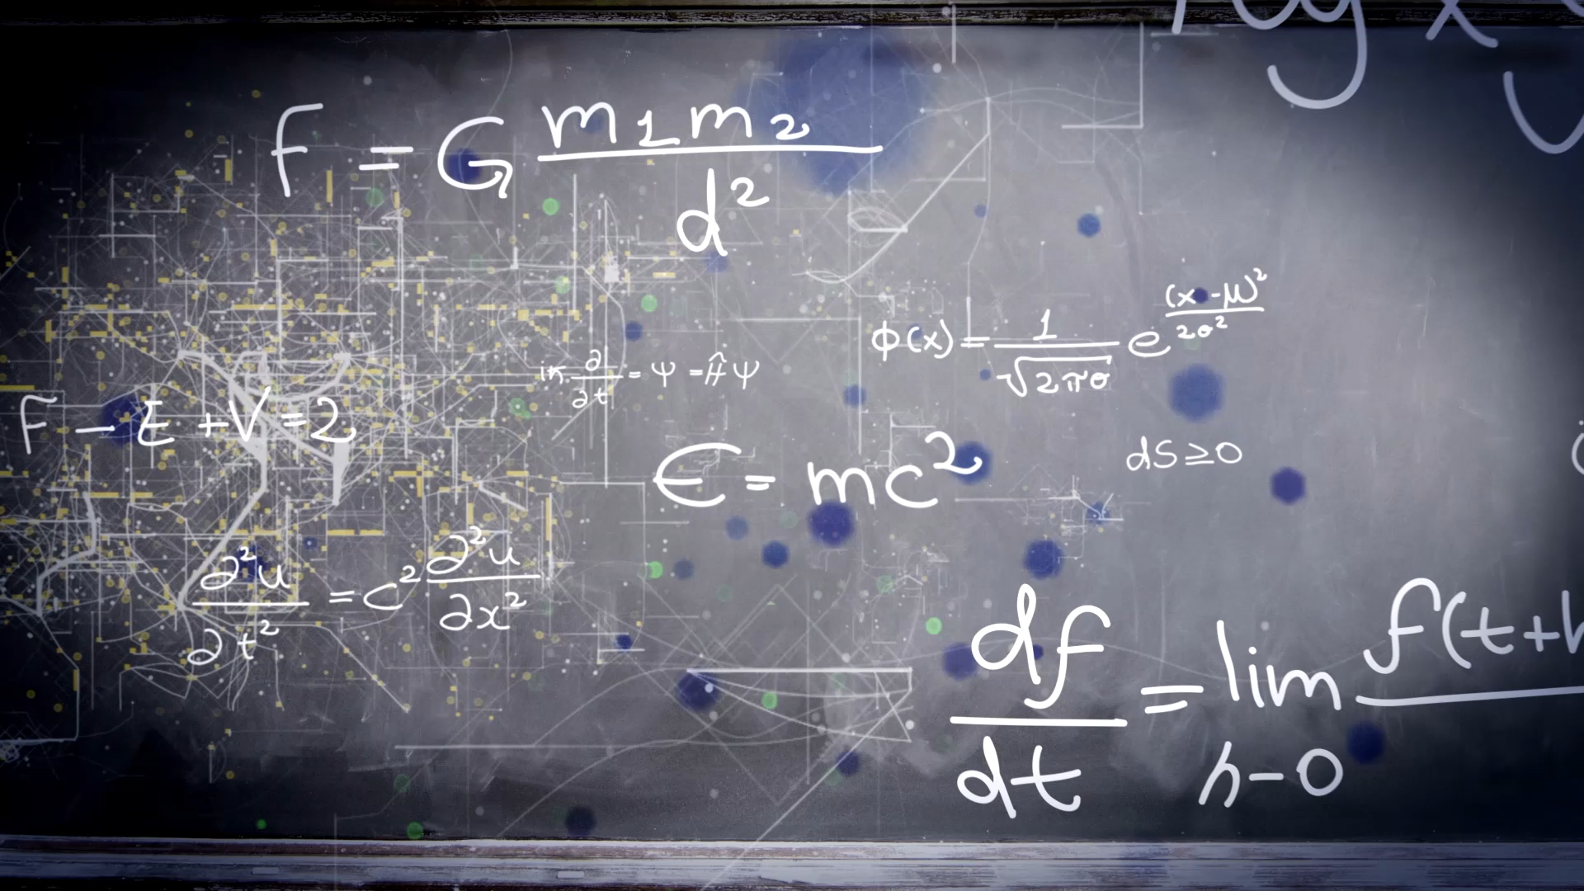
Programming with Applied AI
10 minute Introduction & micro-teach by Mike Watkins

Slide 2
Session Objective
Use a Jupyter Notebook with Python to create a simple Optical Character Recognition program.
Explore, discuss and apply a simple machine learning model with python programming to create a simple, testable AI based OCR solution.
Although not essential, some knowledge of Python would be useful

Slide 3

Google’s Colab
Colab is a free, hosted computing resource that provides Jupyter Notebook services; it requires no (or minimal) setup to use and supports access to GPUs and TPUs.
Notebooks allow us to combine executable code with rich text, images, HTML (and more) in a single document.
Please note
Although you will be able to review any discussed code – you will need to sign-in with a Google account to run the solution

Slide 4
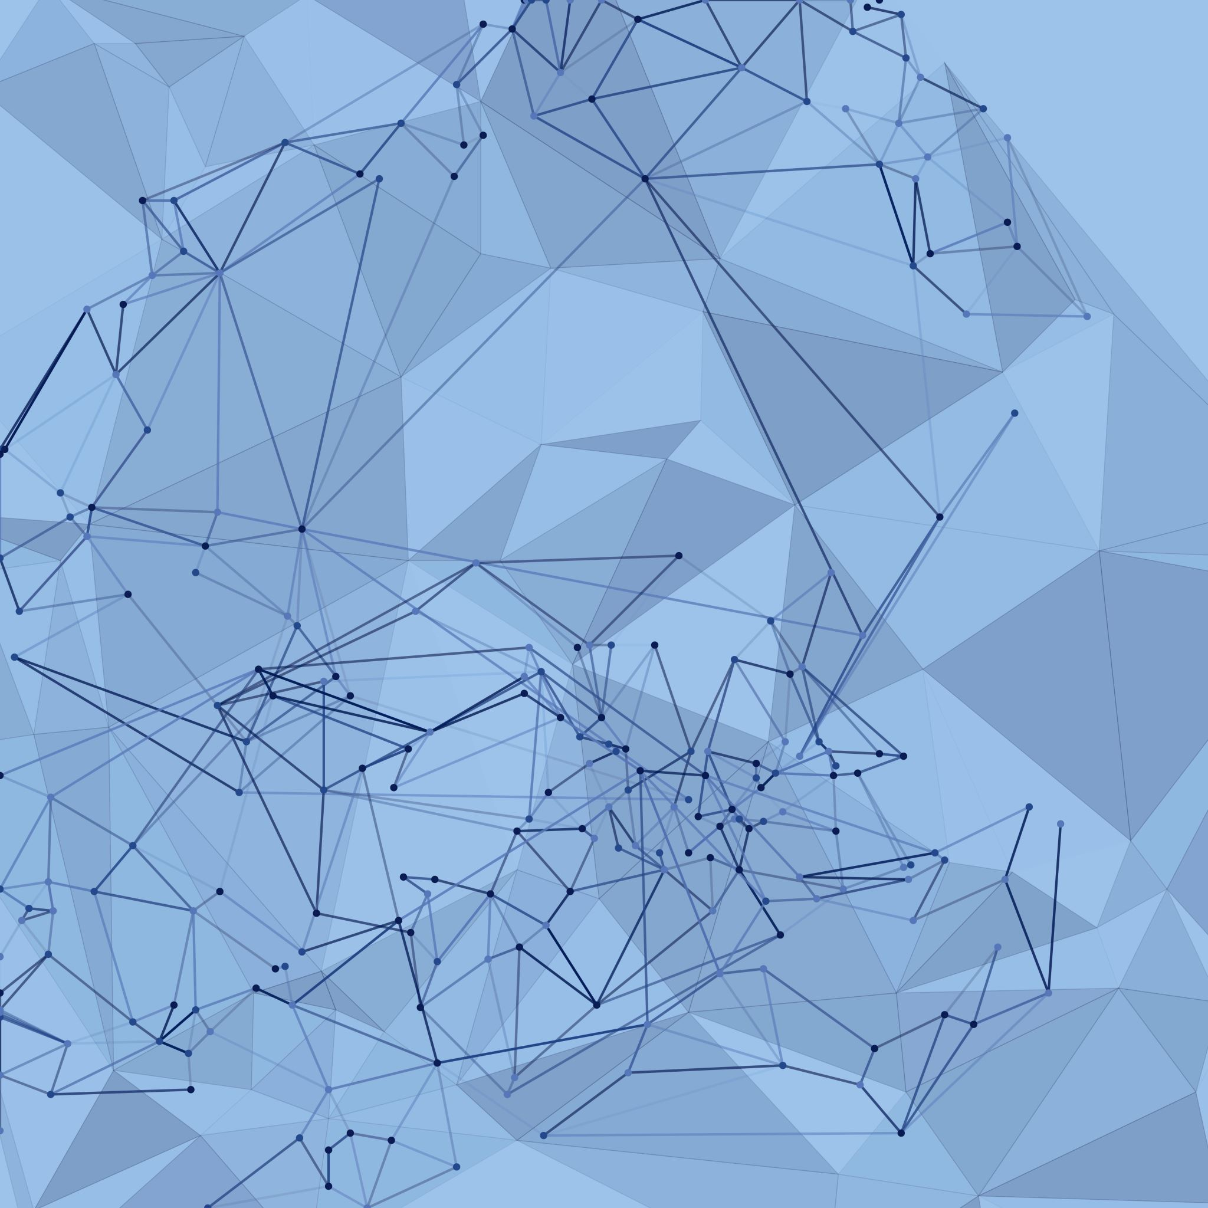
Optical Character Recognition
OCR is a process that converts ‘text based’ images into a machine-readable format.
For example, if we scan a document or shopping receipt, etc your program should be able to extrapolate the text into an editable, searchable version; essentially, we can use OCR to convert an image into a storable, text document.

Slide 5
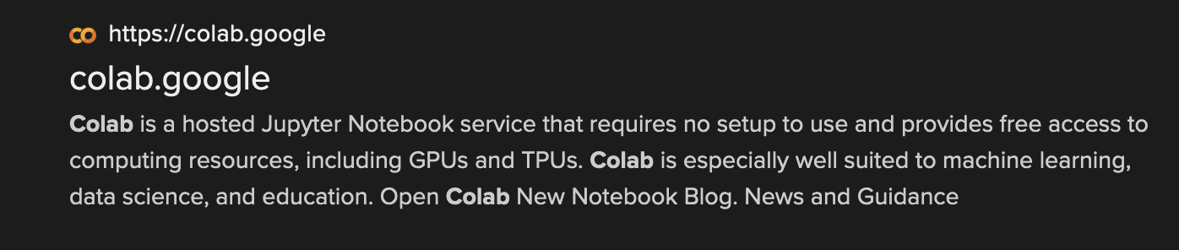
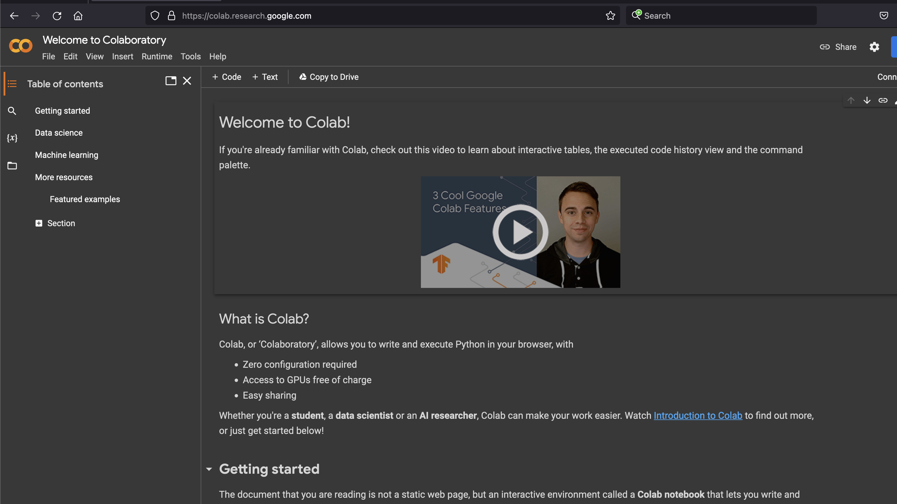
Let’s jump in
Open a browser and search for:
Colab
https://colab.research.google.com

Slide 6
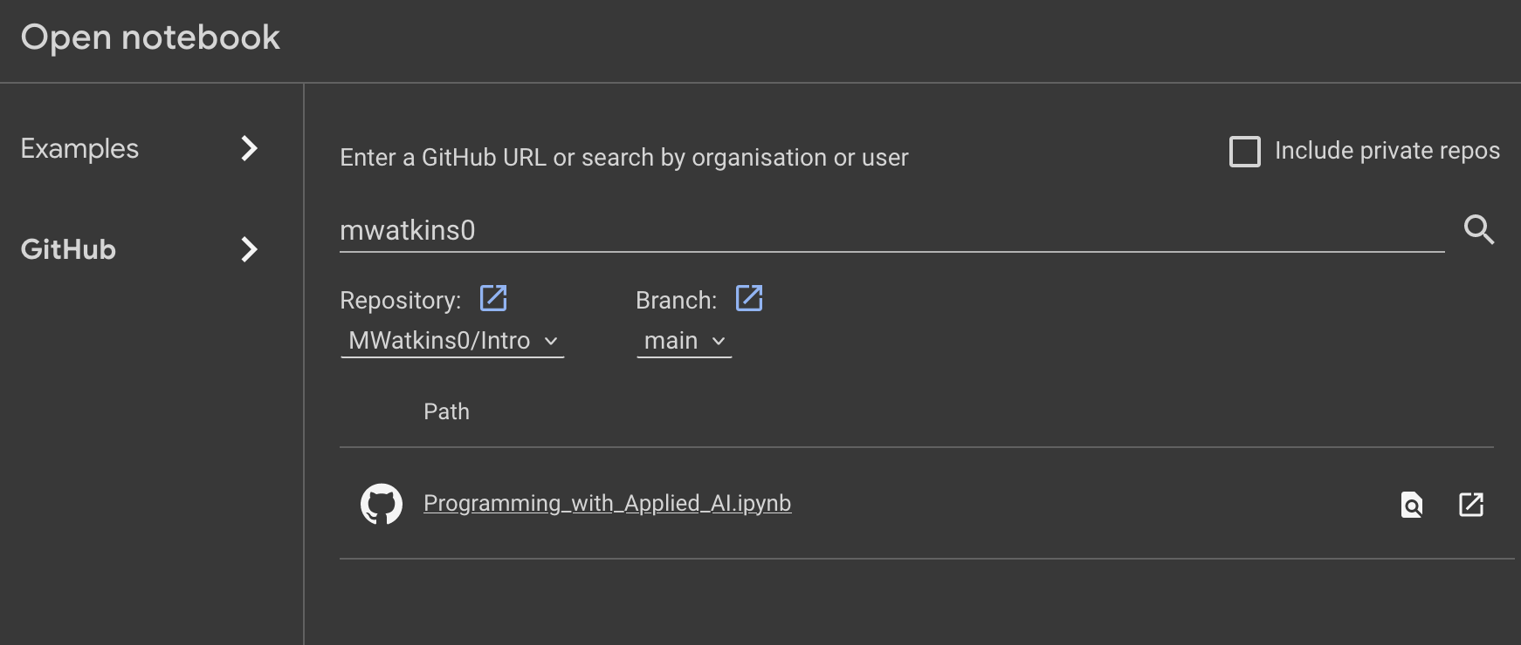
Open notebook
Select ‘File/Open notebook’
Select ’GitHub’ and enter ‘mwatkins0’ as the URL
Select ‘Programming with Applied AI.jpnb’ by clicking the ‘open in a new tab option’

Slide 7
